Slide 1
Bioenergy Research and Demonstration Facility
MARCH 2015 - UPDATE

Slide 2
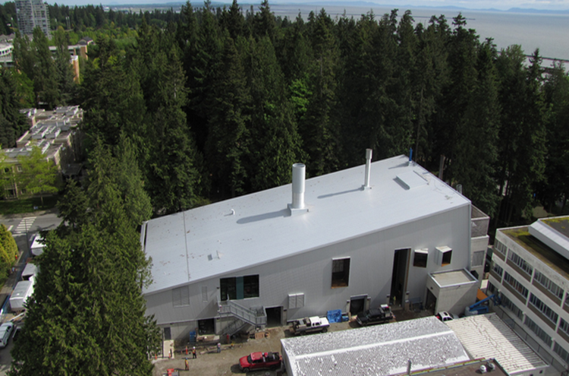
What was the BRDF all about?
By constructing this facility on the UBC campus, lessons can be learned and shared with other universities, communities, governments, and industry that will result in the advancement of new ideas that will meet operational needs, generate new research, and contribute towards the global challenges of climate change
Key operational questions addressed by the BRDF:
Can wood waste destined for the landfill be used to generate thermal energy and/or electricity?
Is biomass a viable method for greenhouse gas emissions reductions?
Is cogeneration from biomass syngas commercially viable?
Can common community concerns with respect to emissions and vehicle traffic from biomass operations be addressed?
Can the benefits of localized (distributed) power generation be monetized?
Can cross-laminated timber (CLT) construction be an added-value industry in British Columbia?

Slide 3
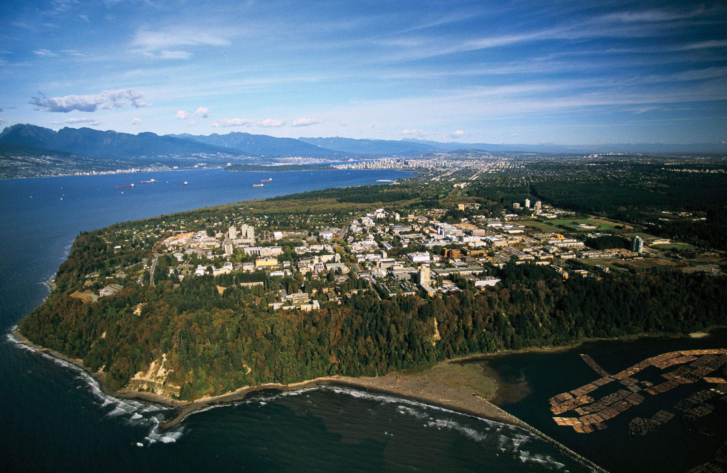
Who’s Involved
UBC Operations, Faculty, Students, Researchers; with industry partners: Nexterra, General Electric, BCHydro; and the local community: UNA, SHHS
UBC project partners include:
BC Bioenergy Network
BC Ministry of Energy, Mines
BC Ministry of Forests
BC Hydro
Ethanol BC
City of Vancouver
FP Innovations
GE Energy
Natural Resources Canada
Nexterra Systems Corp.
Sustainable Development Technology Canada

Slide 4
What is the BRDF?
Summary
Biomass cogeneration demonstration project using syngas clean up technology A social license demonstration A $27.4M multi-partnership project Building constructed from Canadian produced Cross Laminated Timber (CLT) Thermal Mode: 6 MW_{t} or Cogeneration Mode: 2.9 MW_{t} & 2MW_{e}
Why the BRDF made sense?
Positive return on UBC’s investment within 15 years. 12% reduction of UBC CO₂ emissions and offsetting the consumption of 150,000 GJ of natural gas at the Powerhouse Diversifies UBC’s thermal fuel source mix. “Campus as a Living Lab” collaboration between Faculty, Operations & Industry
Notes:
Thermal Mode: 20,000 lb/r
Cogen Mode: 9600 lb/hr

Slide 5
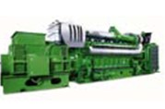
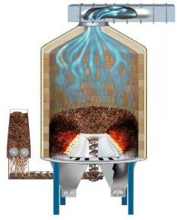
Modes of operation: Thermal only or Research Cogeneration Mode
Engine & HRSG
2 MWe Electrical
1.4 MWt Steam
1 MWt Hot Water
Biomass Cogeneration
Steam
1.5 MWt in CHP mode
Biomass Gasifier
6 MWt peak in Thermal Mode
Thermal Only
Steam Boiler
Equipment
Installed
Production
Notes:
Commercial (Thermal)
→ produces 20k lbs/hr steam (≅ 25% of current campus use)
Demonstration (Thermal & Electricity)
→ produces 1.9 MWe (gross) electrical power (≅ 5% of Campus demand) and 9.6k lbs/hr steam (≅ 12% of current campus use)
Goal:
Demonstrate technical and commercial viability of 2 MWe combined heat and electrical power bioenergy system

Slide 6
What were some of the barriers overcome / lessons learned?
What were the social licence barriers of the BRDF?
biomass sourcing
building siting
truck traffic
air emissions

Slide 7
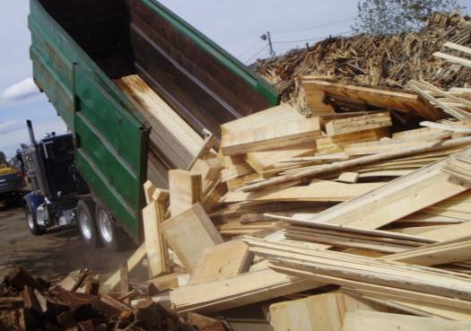
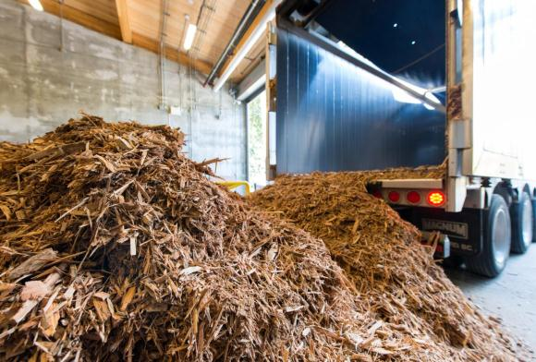
Fuel (Biomass) Sourcing
Fuel is ground & chipped waste wood:
Sawmill residuals
Furniture/carpentry offcuts
Municipal trimmings
Land clearing operations
Fuel is renewable as it diverts wood waste from landfills where it would otherwise rot and produce methane.
Uses 2-4 trucks per day for 12,500 dry tonnes per year.
Notes:
Operational ~100 days

Slide 8
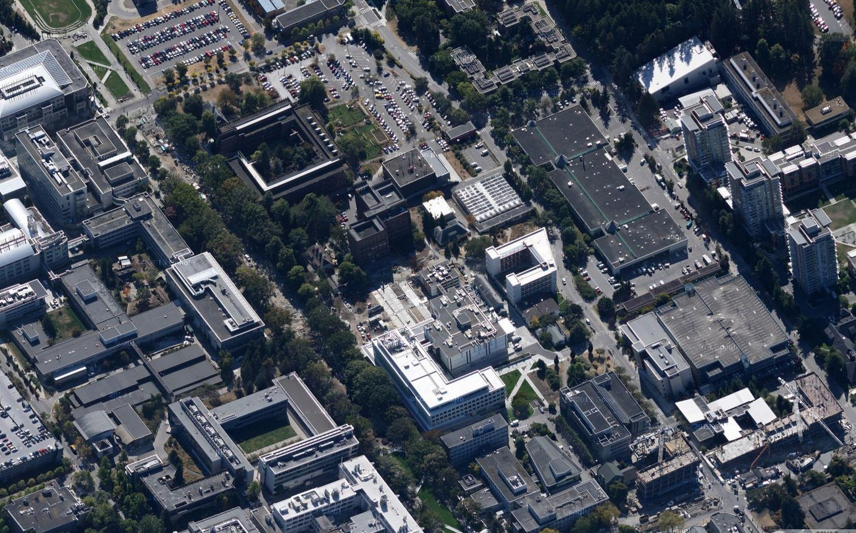
Social License: BRDF Siting
Housing
Housing
Childcare
Childcare
The site was chosen to be a first of its kind in BC, for a social license, to demonstrate a biomass/cogeneration facility in a high density urban setting
Secondary consideration for site was the close proximity to Marine Drive and operational support

Slide 9
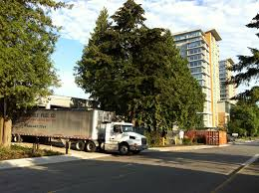
Above & beyond: Ambient Air Monitor
Emission Dispersion Study showed Marine Tower 5 as the most likely residential building for air emission impact
June 2012, UBC proactively installed a real time Ambient Air Monitor on Marine Tower 5
Automatic emails alerts if air quality limits are exceeded
24 hour average PM 2.5 < 25 µg/m³ or
1 hour NO₂ < 107 ppb
Air emissions remain well below Metro Vancouver limits
Notes:
Emission Dispersion Study identified the top of Marine Tower #5 to be the worse case scenario for air containments from the BRDF
June 1st 2012 RWDI completed the installation of the ambient air monitor on the roof of the adjacent student residences building.
Monitor provides real time data for ambient levels of:
PM 2.5
NO₂
NO
Automatic emails are sent to BO if levels exceed the Metro Vancouver air quality objectives of
24 hour average PM 2.5 < 25 µg/m³
1 hour NO₂ < 107 ppb

Slide 10
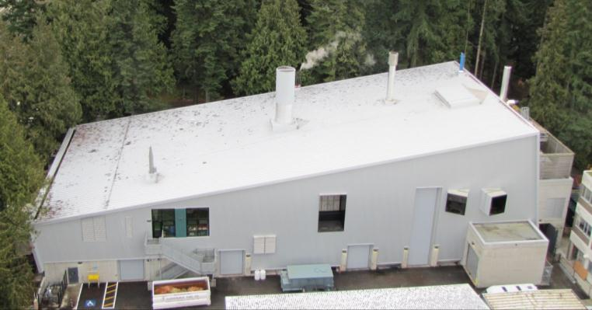
BRDF Air Emissions (Performance)
Permit Requirements
PM Particulate Matter
NO_{x} Nitrogen Oxides
VOC Volatile Organic Compounds
Opacity
Dryer
Permit | Test
15 | 3.9
- | -
10.4 | 9.6
5% | <5%
Boiler
Permit | Test
15 | 2.1
272 | 230
10.5 | 2.2
5% | 0%
Engine
Permit | Test
15 | 1.3
249.7 | 105
40.9 | 31
5% | <5%
Verified by 3rd party testing (Al Franco)
Unless otherwise noted, all units are in mg/m3

Slide 11
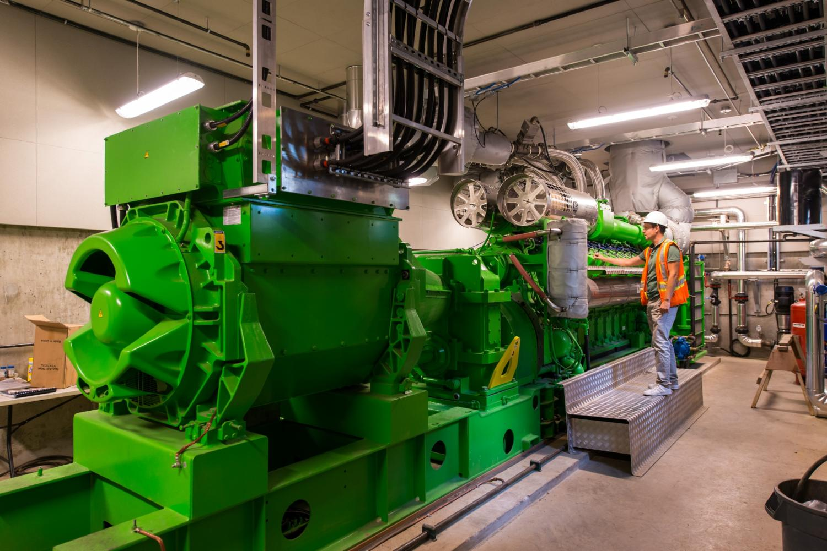
How are we using the BRDF to advance research/industry?
Photo Credit: Don Erhardt
Notes:
Operational ~100 days

Slide 12
BRDF: RESEARCH ACTIVITIES
The active commercial operation of the UBC system spawned the development of 11 spin‐off R&D projects at UBC engaging 14 UBC faculty and a larger number of students
Catalytic Tar Cracking - Primary Investigator: Dr. John R Grace, Dr. Tony Bi
High Temp. Hydrogen Membrane Extraction - Primary Investigator: Dr. John R Grace, Dr. Jim Lim
CLT Life Cycle Study - Primary Investigator: Dr. Alberto Cayuela
MetroVancouver Fuel Study - Primary Investigator: Dr. Shahab Sokhansanj, Dr. Anthony Lau
Implication on testing of pipeline materials exposed to hydrogen - Primary Investigator: Dr. Chad Sinclair, Dr. Matt Roy
Added Value Ash Study - Primary Investigator: Dr. Tom Troczynski
Examination of Corrosion Mechanisms in Steel Vessels - Primary Investigator: Dr. Akram Alfantazi
Metallurgical Investigation of Materials Issues at the BRDF - Primary Investigator: Dr. Steve. Cockcroft
B2H Advanced Gas Program - Primary Investigator: Nexterra/UBC/Fortis/Quadrogen
Electro‐Chemical Energy Storage (ECES) - Primary Investigator: Dr. Martin Ordonez
Advanced Integrated AC‐DC Systems - Primary Investigator: Dr. Juri Jatskevich
Photo Credit: Don Erhardt
Notes:
Operational ~100 days

Slide 13
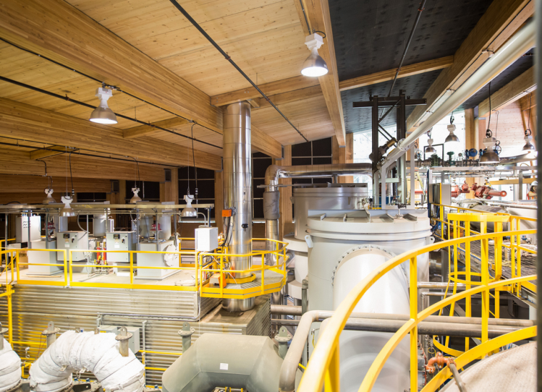
How has this project enhanced UBC’s reputation?
### of Tours
International/High profile Visitors
Awards

Slide 14
Building UBC’s reputation
### of Tours
International/High profile Visitors
Awards
400+ Tours:
Creative Energy, University of Hokkaido, Office of Energy Research and Development, Sustainable Development Canada, University of Antwerp, UBS Global Asset Management, FortisBC, SFU, and others
Awards:
2012 LEED Gold Building
2012 KPMG Infrastructure 100 Award: Outstanding efforts in urban infrastructure
2013 Canadian Wood Council Wood Building & Design Award: In recognition of excellence in architectural design using wood for commercial large projects.

Slide 15
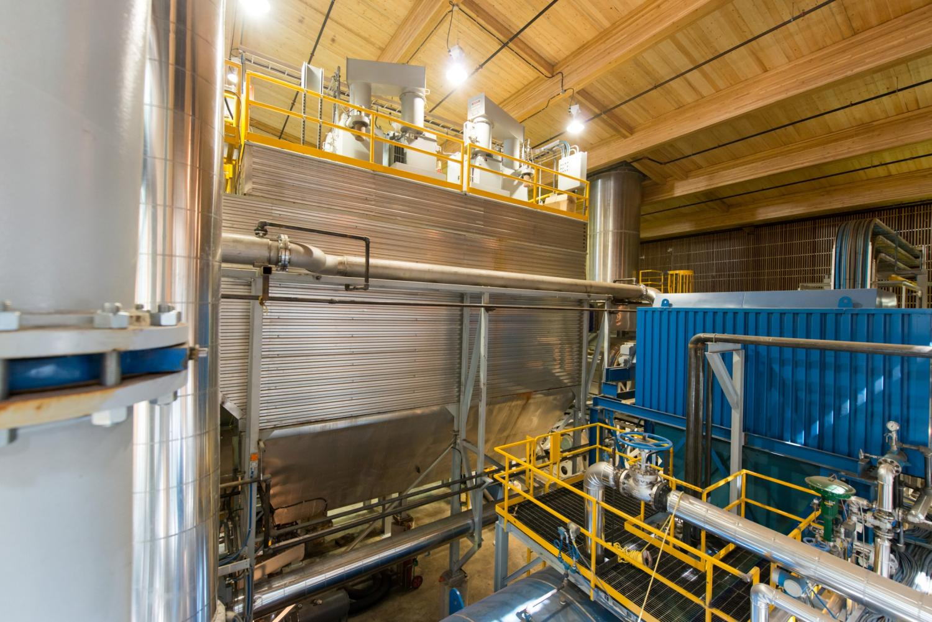
Building UBC’s reputation
Reference site for Nexterra’s United Kingdom contracts (first of five)
Metro Vancouver: Biomass Social License
Successful technology development option for both the federal and provincial government
FortisBC – Renewable Natural Gas (RNG)
GE first dual fuelled gas engine
Commercial Applications of Cross Laminated Timber

Slide 16
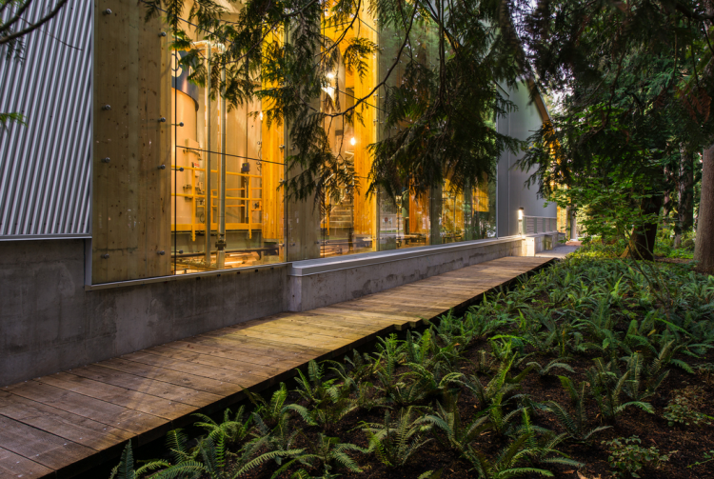
How has the BRDF performed?
2 MVA contribution to electrical capacity constraint issue.
Mitigated peak capacity of powerhouse boilers (originally approved to be replaced in 2008/09)
Etc…

Slide 17
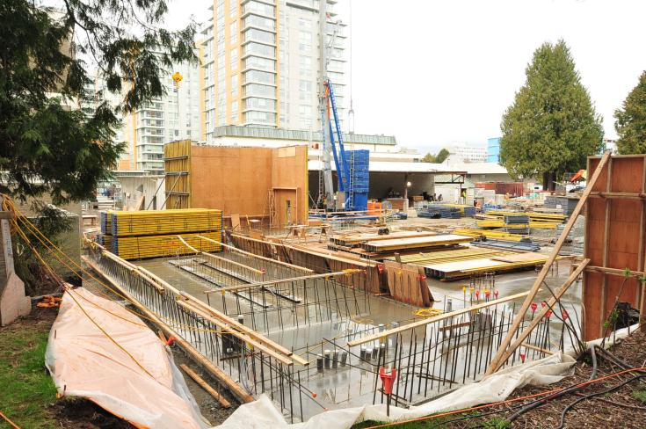
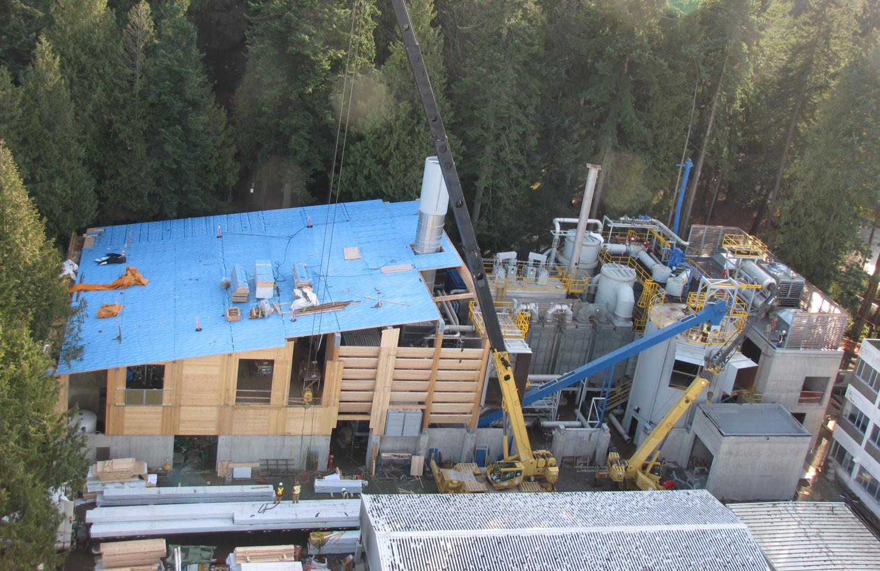
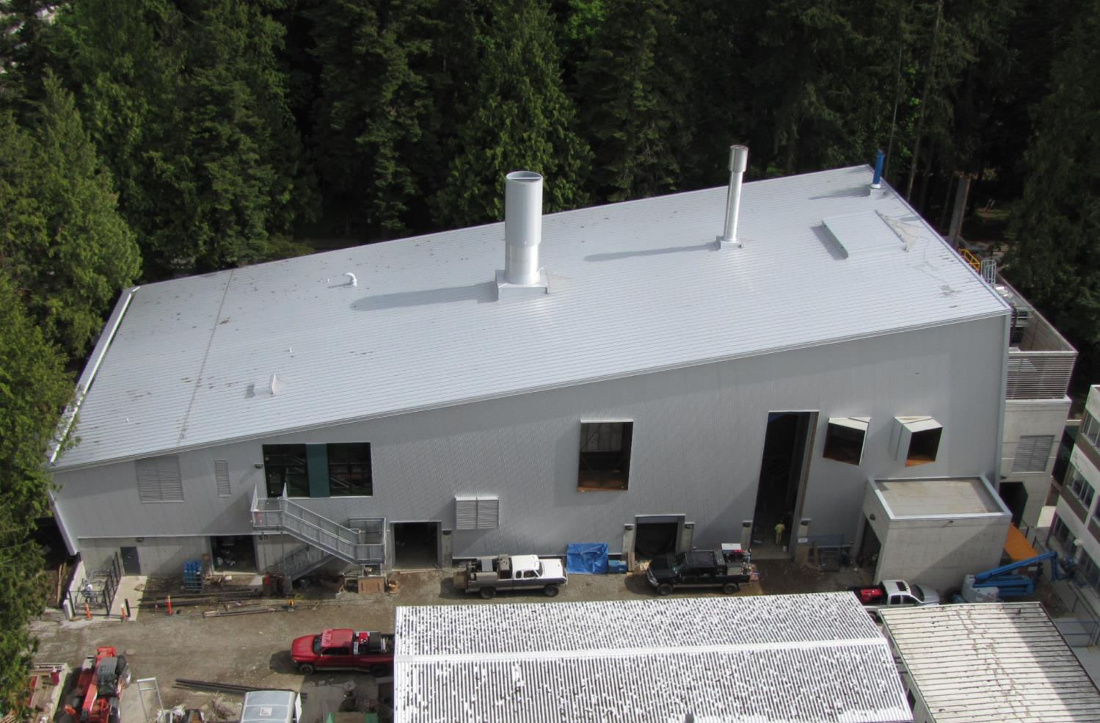
Construction May 2011
Project Roadmap
Spring 2009 BRDF Concept devised
Spring- Fall 2010 Public Engagement
April 2010 UBC Board Approval
Feb. 2011 Groundbreaking
July 2012 Thermal Mode Commissioned
Sept 2012 Grand Opening Ceremony
Oct. 2012 Combined Heat + Power (CHP) Mode Commissioned
Nov. 2012 Full Operation
July 2014 Renewable Natural Gas (RNG) CHP Commissioned
Construction Jan 2012
Construction May 2012

Slide 18
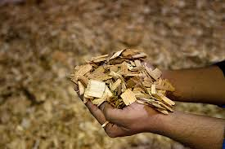
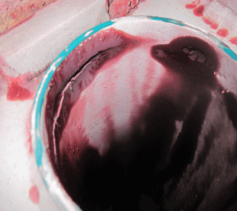
PERFORMANCE: LESSONS LEARNED (Biomass Cogeneration)
Requires a higher biomass fuel quality than expected (<30% moisture content)
Syngas clean up process equipment failures. Requires several system upgrades to resolve
Higher operational costs than expected e.g. people, maintenance and materials
Notes:
Higher Operational Costs
No additional labour was accounted for Cogen Operations. It is a 5 day process with 2 man 24/7 operators to get the engine running.
Carbon annual costs of 365k vs 150k in OBC
Higher fuel quality is required
<30% Moisture for CHP startup until engine is running and dryer is available

Slide 19
PERFORMANCE: ENHANCED
BRDF | Biomass Thermal | Biomass Cogeneration
Steam Boiler | 6.0 MWt (20,000lbs) | 1.5 MWt (5,000lbs)
Heat Recovery Steam Generator (HRSG) | - | 1.4 MWt (4,600lbs)
Hot Water Engine Heat Recovery | - | 1 MWt
Electrical Energy | - | 2 MWe
TOTAL | 6 MW | 5.9 MW
Biomass Thermal & RNG Cogeneration
6.0 MWt (20,000lbs)
1.4 MWt (4,600lbs)
1 MWt
2 MWe
10.4 MW*
Note 1MWt = 1 MegaWatt (thermal) = 3,333lbs steam
*75% increase in energy production

Slide 20
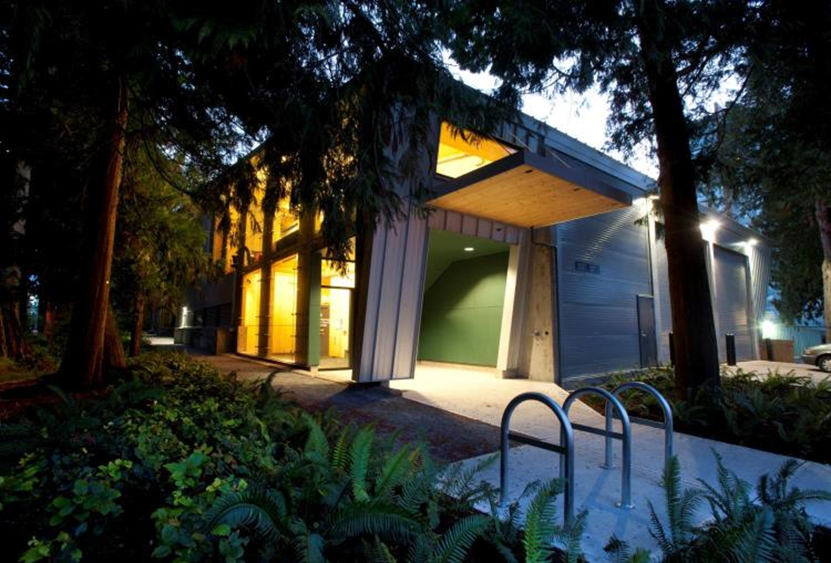
BRDF PERFORMANCE
BRDF Project | Original Business Case | The Current Situation
Remaining principle ($8.35M loan) | $8.35M | $7.4M
Annual O&M cost | $1.4M | $1.1M
Annual fuel input cost¹ | $0.8M | $2.6M
Price of Natural Gas (2015) | $11.1/GJ | $8.5/GJ
Revenue generated | $3.2M | $3.9M
break-even forecast² | 2026 | 2028
Fuel Input costs are considerably higher due to 1) the use of renewable natural gas as the primary fuel for cogen, and 2) the plant is now operating in full thermal and cogen modes simultaneously. The break-even forecast is extended by 2 years due to 1) the delayed completion of the project, and 2) our unsuccessful efforts to reliably produce electricity from syngas.
 | FY15
Steam Produced (MWh) | 40,000
Portion of Campus Thermal load from the BRDF | 23.4%
GJ of natural gas offset | 145,000 GJ
Tonnes CO2 offset | 6,780
Electricity Produced (MWh) | 9,900
Photo Credit: Don Erhardt
Notes:
Operational ~100 days
Steam Produced (Million of lbs): 110.7 Thermal mode + 22.3 HRSG steam + 7.2 Hot water = 140.2 million of lbs
Portion of Campus Use(Million of lbs): Total production = 645.0, total campus use = 612.6
GJ of NG offset = 145,999GJ from thermal mode + 29,425 GJ HRSG + 9,439 GJ HW = 184,863 GJ
Thermal mode Tonnes CO2 offset = thermal mode Gas offset = 7298 tCo2, thermal mode gas addition: -72tCo2, biomass carbon add: -345tCo2 = 6880 tCo2
Electricity Produced (Mwh) 9806 MWh

Slide 21
BRDF PERFORMANCE
Mitigates UBCV electricity capacity constraints
Mitigated steam capacity constraint and avoided powerhouse boiler replacement cost.
Enables transition from the existing powerhouse to the new campus energy centre by providing the thermal summer base load of the campus (2015).
2 MVA contribution to electrical capacity constraint issue.
Mitigated peak capacity of powerhouse boilers (originally approved to be replaced in 2008/09)
Etc…

Slide 22
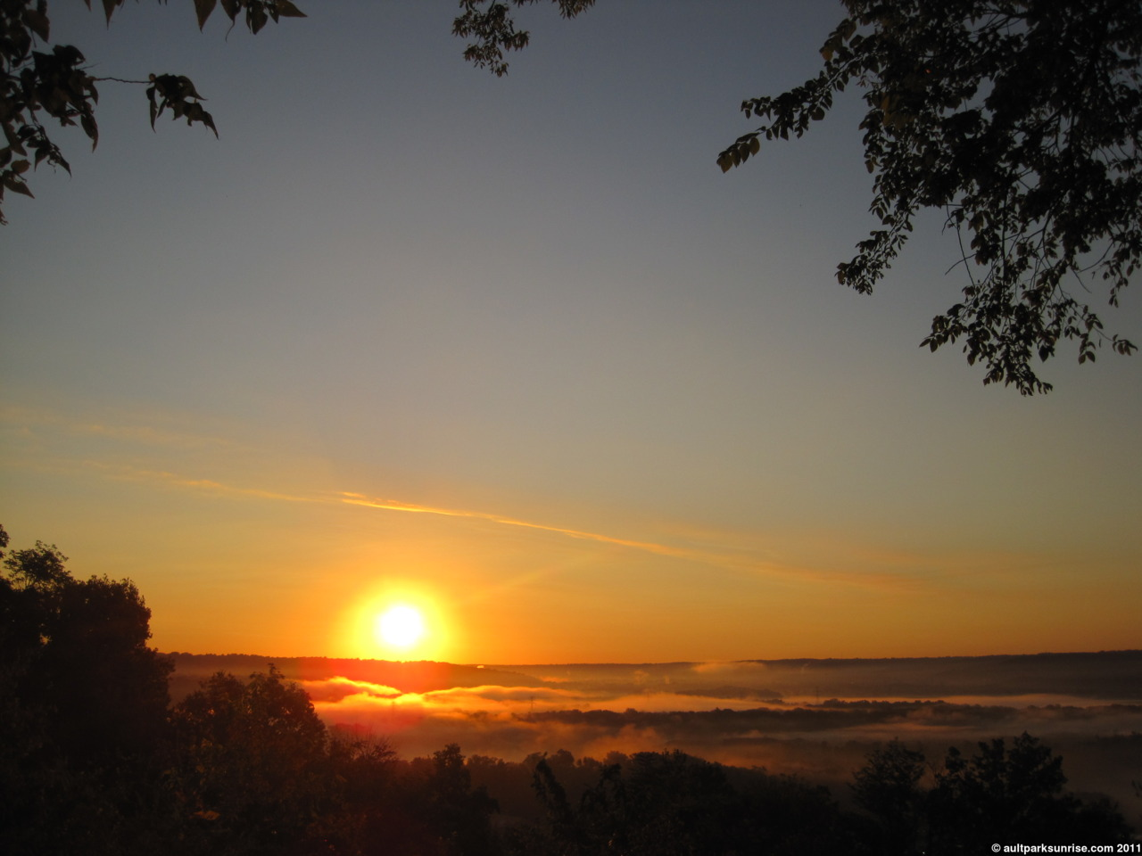
NEXT STEPS:
Continue to work with FortisBC to reduce the cost of renewable natural gas.
Continuous improvement to operations and efficiency.
Pre-feasibility study of expanded biomass operation to meet 2020 greenhouse gas reduction target.

Slide 23
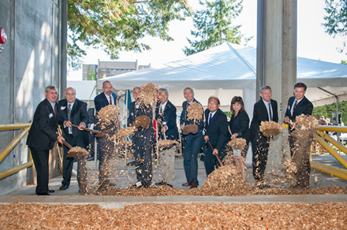
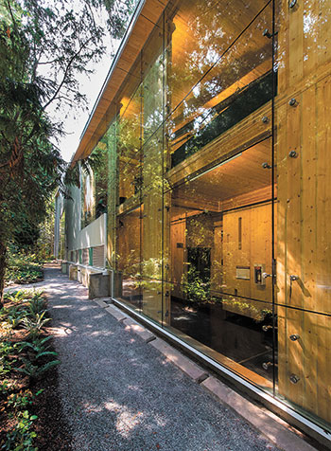
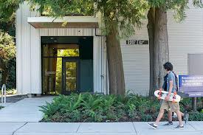
Thank You
David Woodson
Managing Director, Energy + Water Services
david.woodson@ubc.ca

Slide 24
